Slide 1
RED-BLACK TREES

Slide 2
Construct a BST from a sorted array
[1,2,3,4]

Slide 3
1

Slide 4
1
2

Slide 5
1
2
3

Slide 6
1
2
3
4
It is a linked list: O(N) !!!

Slide 7
The running time of BST operations depends on the height of the binary search tree: we should keep the tree balanced in order to get the best performance
In an AVL tree, the heights of the two child subtrees of any node differ by at most one
Another solution to the problem is a red-black trees
AVL trees are faster than red-black trees because they are more rigidly balanced BUT needs more work
Operating Systems relies heavily on these data structures !!!

Slide 8
 | Average case | Worst case
Space | O(n) | O(n)
Insert | O(log n) | O(log n)
Delete | O(log n) | O(log n)
Search | O(log n) | O(log n)

Slide 9
Red-black properties:
Each node is either red or black
The root node is always black
All leaves (NIL or NULL) are black
Every red node must have two black child nodes and no other children → it must have a black parent
Every path from a given node to any of its descendant NIL/NULL nodes contains the same number of black nodes

Slide 10
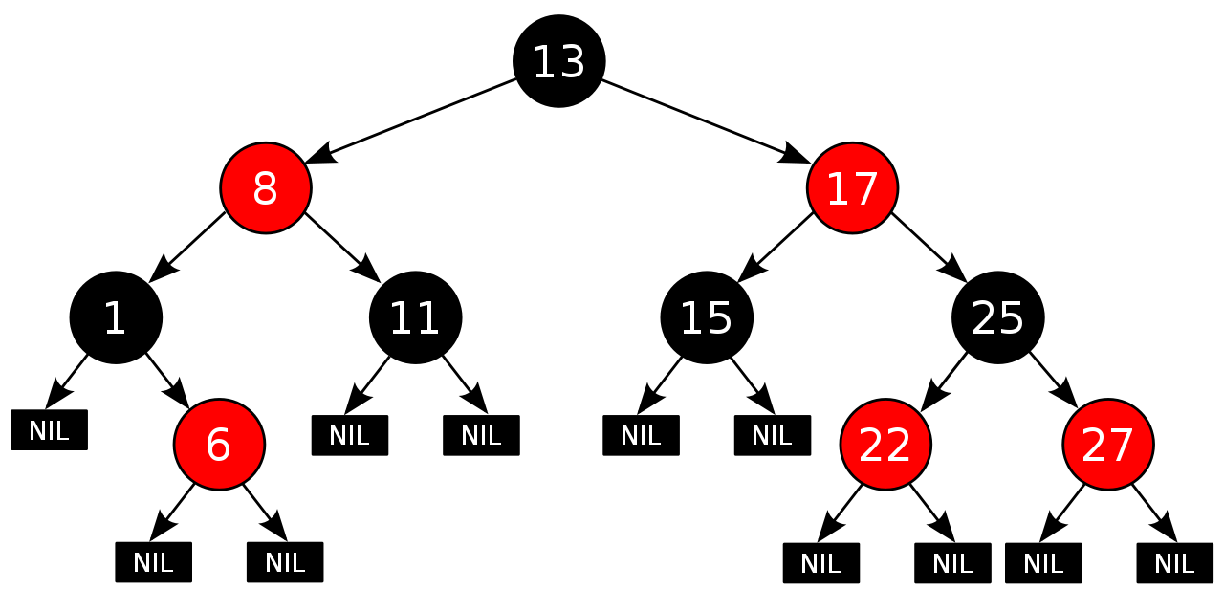

Slide 11
Rotations
D
B
B
E
rightRotate(D)
A
D
A
C
leftRotate(B)
C
E
We just have to update the references which can be done in O(1)
time complexity !!! ( the in-order traversal is the same )

Slide 12
Every new node is red by default
We keep inserting new node in the same way as we have seen for binary search trees ( or AVL trees )
On every insertion → we have to check whether we have violated the red-black properties or not
If we have violated the RB properties: we have to rebalance the tree
1.) make rotations
2.) OR just recolor the nodes

Slide 14
Case 1:
D
E
A
x
B
C

Slide 15
Case 1:
This problem is symmetric !!!
D
E
A
B
A
x
x
E
B
C
C
D

Slide 16
Case 1:
The „uncle” of x is red too !!!
D
E
A
x
B
C

Slide 17
Case 1:
We just have to recolor some nodes, quite
easy case
D
E
A
x
B
C

Slide 18
Case 1:
We just have to recolor some nodes, quite
easy case + the x will be the root node in this case
x
IMPORTANT: with this recoloring, maybe we
violate the red-black properties in other
parts of the tree !!!
~ have to check recursively on the whole tree
D
E
A
B
C

Slide 19
Case 1:
We have to check recursively (fom bottom to top)
whether the red-black properties are violated or not
x
D
E
A
B
C

Slide 20
Case 1:
A
B
x
E
C
D

Slide 21
Case 1:
A
B
x
E
C
D

Slide 22
Case 1:
A
B
x
E
C
D

Slide 23
Case 1:
x
A
B
E
C
D

Slide 25
Case 2:
D
E
A
x
B
C

Slide 26
Case 2:
The uncle of node x is a black node + node x is a right child
D
E
A
x
B
C

Slide 27
Case 2:
The uncle of node x is a black node + node x is a right child
uncle
D
E
A
x
B
C

Slide 28
Case 2:
D
E
A
x
B
C

Slide 29
Case 2:
The uncle of node x is a black node + node x is a right child
We have to make a left rotation on the node x’s parent
D
E
A
x
B
C

Slide 30
Case 2:
D
E
A
x
B
C

Slide 31
Case 2:
The uncle of node x is a black node + node x is a right child
We have to make a left rotation on the node x’s parent
We have to rotate the blue node !!!
D
E
A
x
B
C

Slide 32
Case 2:
D
E
A
x
B
C

Slide 33
Case 2:
The uncle of node x is a black node + node x is a right child
We have to make a left rotation on the node x’s parent
x
D
E
D
E
A
x
C
B
C
A
B

Slide 34
Case 2:
same problem basically but the symmetric version
A
B
x
E
C
D

Slide 35
Case 2:
The given x node is a left child
+ the parent is red
+ the uncle is black
A
B
x
E
C
D

Slide 36
Case 2:
The given x node is a left child
+ the parent is red
+ the uncle is black
A
B
x
E
C
D

Slide 37
Case 2:
The given x node is a left child
+ the parent is red
+ the uncle is black
A
B
x
E
C
D

Slide 38
Case 2:
The given x node is a left child
+ the parent is red
+ the uncle is black
We just have to make a right rotation
on the blue node !!!
A
B
x
E
C
D

Slide 39
Case 2:
x
A
B
x
E
A
B
C
C
D
D
E

Slide 41
Case 3:
Uncle of node x is black and node x is a left child
D
E
x
C
A
B

Slide 42
Case 3:
Uncle of node x is black and node x is a left child
uncle
D
E
x
C
A
B

Slide 43
Case 3:
Uncle of node x is black and node x is a left child
We have to make a rotation on x node’s grandparent
D
E
x
C
A
B

Slide 44
Case 3:
Uncle of node x is black and node x is a left child
We have to make a rotation on x node’s grandparent
x’s grandparent
D
E
x
C
A
B

Slide 45
Case 3:
Uncle of node x is black and node x is a left child
We have to make a rotation on x node’s grandparent
x’s grandparent: we have to rotate this node
D
E
x
C
A
B

Slide 46
Case 3:
Uncle of node x is black and node x is a left child
We have to make a rotation on x node’s grandparent
x
D
E
A
B
x
C
C
A
B
It is important that after the rotations
we have to make some recoloring as well !!!
D
E

Slide 47
Case 3:
The symmetric version is basically the same just
rotate in the opposite direction
A
B
C
X
D
E

Slide 48
Case 3:
The symmetric version is basically the same just
rotate in the opposite direction
x
A
B
D
E
C
X
C
D
E
A
B

Slide 50
Case 4:
Uncle of node x is black and node x is a left child
+ uncle is red here in this case
We have to recolor some nodes !!!
D
E
x
C
A
B

Slide 51
Case 4:
Uncle of node x is black and node x is a left child
We have to recolor some nodes
x
íííí
D
E
D
E
x
C
C
A
B
A
B

Slide 52
Case 4:
This is the same problem but the symmetric
version !!!
A
B
C
X
D
E

Slide 53
Case 4:
This is the same problem but the symmetric
version !!!
x
A
B
A
B
C
C
X
D
E
D
E

Slide 54
Example:

Slide 55
Example:
insert(1)

Slide 56
Example:
insert(1)
1

Slide 57
Example:
insert(1)
1

Slide 58
Example:
insert(2)
1

Slide 59
Example:
insert(2)
1

Slide 60
Example:
insert(2)
1
2

Slide 61
Example:
insert(3)
1
2

Slide 62
Example:
insert(3)
1
2

Slide 63
Example:
insert(3)
1
2

Slide 64
Example:
1
2
3
It is the Case 3: because the NULL is considered to be a black node
→ the uncle of Node 3 is black
Have to make a rotation + recolor the nodes if
necessary

Slide 65
Example:
1
NULL
2
3
It is the Case 3: because the NULL is considered to be a black node
→ the uncle of Node 3 is black
Have to make a rotation + recolor the nodes if
necessary

Slide 66
Example:
insert(4)
2
1
3

Slide 67
Example:
insert(4)
2
1
3

Slide 68
Example:
insert(4)
2
1
3

Slide 69
Example:
2
1
3
4

Slide 70
Example:
2
1
3
4
It is the Case 1: the given node 4 and the parent are both red + uncle is red
Color uncle + parent to be black

Slide 71
Example:
2
1
3
4
It is the Case 1: the given node 4 and the parent are both red + uncle is red
Color uncle + parent to be black

Slide 72
Example:
2
1
3
4
It is the Case 1: the given node 4 and the parent are both red + uncle is red
Color uncle + parent to be black
VIOLATES THE PROPERTIES AGAIN
Root has to be black as well

Slide 73
Example:
insert(5)
2
1
3
4

Slide 74
Example:
insert(5)
2
1
3
4

Slide 75
Example:
insert(5)
2
1
3
4

Slide 76
Example:
insert(5)
2
1
3
4
5

Slide 77
Example:
This is the Case 3 situation, we have to make
some rotations !!!
2
1
3
4
5

Slide 78
Example:
2
1
4
3
5

Slide 79
Example:

Slide 80
Example:
32
10
55
1
19
79
16
23

Slide 81
Example:
We want to insert 12
32
10
55
1
19
79
16
23

Slide 82
Example:
We want to insert 12
32
10
55
1
19
79
16
23

Slide 83
Example:
We want to insert 12
32
10
55
1
19
79
16
23

Slide 84
Example:
We want to insert 12
32
10
55
1
19
79
16
23

Slide 85
Example:
We want to insert 12
32
10
55
1
19
79
16
23

Slide 86
Example:
32
10
55
1
19
79
16
23
12

Slide 87
Example:
On every insertion we have to check whether
the red black tree properties are violated or not !!!
32
10
55
1
19
79
16
23
12

Slide 88
Example:
On every insertion we have to check whether
the red black tree properties are violated or not !!!
32
10
55
1
19
79
16
23
12
It is violated because red node has a single red child

Slide 89
Example:
32
10
55
1
19
79
16
23
12
This is the Case1 situation: we just have
to recolor nodes

Slide 90
Example:
32
10
55
1
19
79
16
23
12
This is the Case1 situation: we just have
to recolor nodes

Slide 91
Example:
We have to check whether
the red black tree properties are violated or not !!!
32
10
55
1
19
79
16
23
12

Slide 92
Example:
32
This is the Case2
situation !!!
10
55
1
19
79
16
23
12

Slide 93
Example:
32
This is the Case2
situation !!!
10
55
1
19
79
16
23
12
We have to make a left rotation on node 10 !!!

Slide 94
Example:
32
19
55
10
23
79
1
16
12

Slide 95
Example:
We have to check whether
the red black tree properties are violated or not !!!
32
19
55
10
23
79
1
16
12

Slide 96
Example:
We have to check whether
the red black tree properties are violated or not !!!
32
This is the Case3
situation !!!
19
55
10
23
79
1
16
12

Slide 97
Example:
We have to check whether
the red black tree properties are violated or not !!!
32
This is the Case3
situation !!!
19
55
10
23
79
1
16
12
We have to make a right rotation
on the root node !!!

Slide 98
Example:
19
10
32
1
16
23
55
79
12

